Slide 1
Robust Rotation Search: Theory and Algorithms
Talk @AI TIME (Virtual)
December 8, 2022
Liangzu Peng
Mathematical Institute for Data Science, Johns Hopkins University

Slide 2
Robust Rotation Search: Theory (Part I)
“Semidefinite Relaxations of Truncated Least-Squares in Robust Rotation Search: Tight or Not”
ECCV 2022 (26 pages)
Liangzu Peng, Mahyar Fazlyab, Rene Vidal

Slide 3
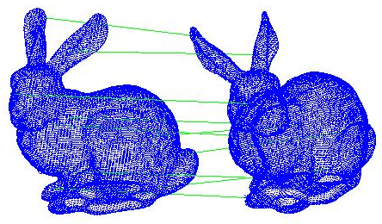
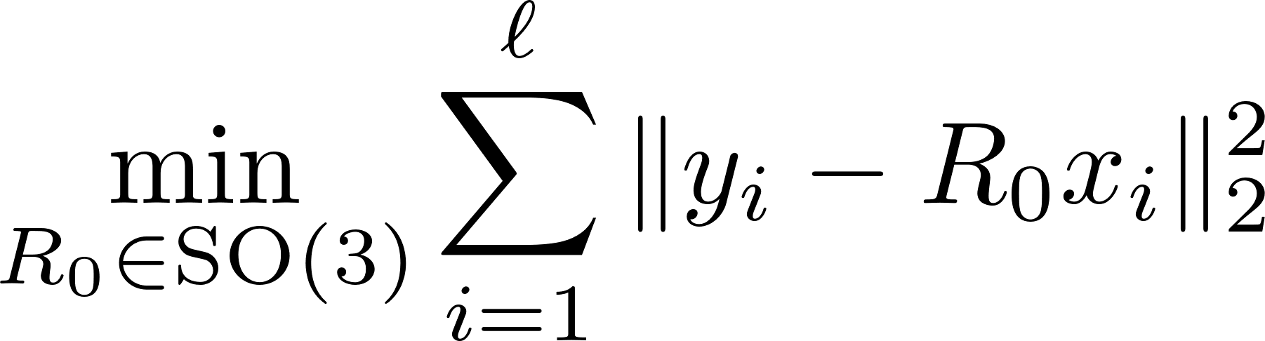
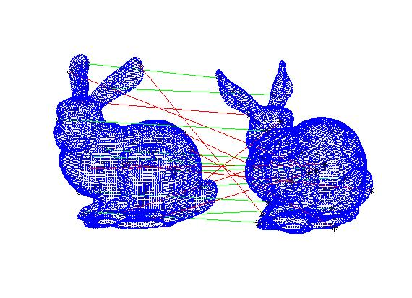
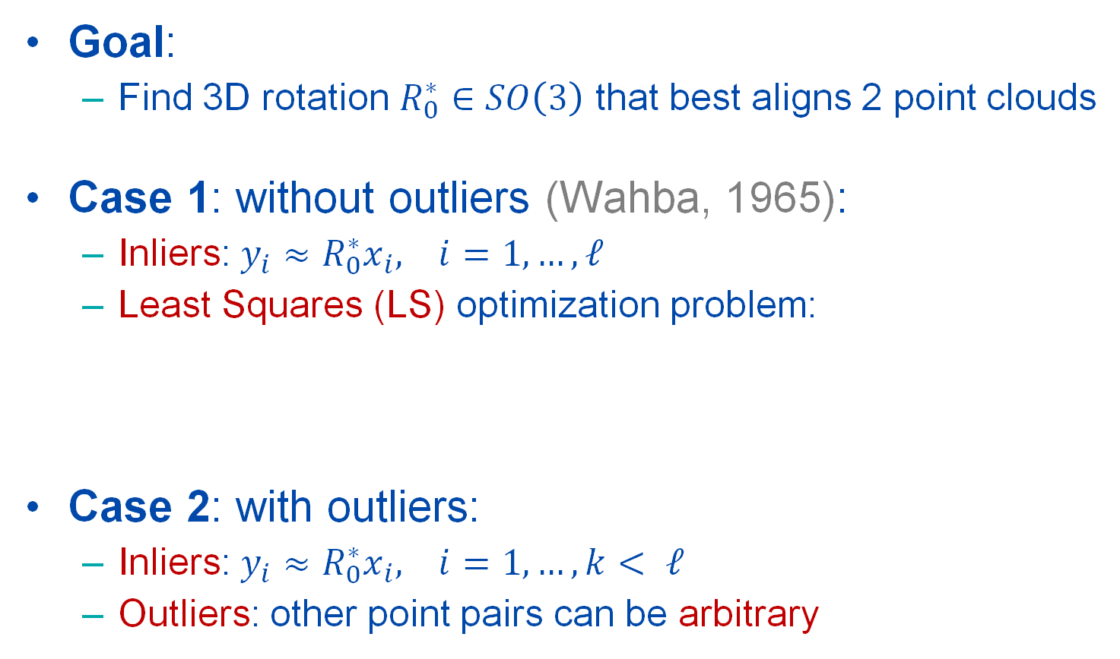
Problem: Outlier-Free Rotation Search
Goal:
Find 3D rotation $R_{0}^{∗}∈SO\left(3\right)$ that best aligns 2 point clouds
Case 1: without outliers (Wahba, 1965):
Inliers: ${{y_{i}≈R}_{0}^{∗}x}_{i}, i=1,…,ℓ$
Least Squares (LS) optimization problem:
Case 2: with outliers:
Inliers: ${{y_{i}≈R}_{0}^{∗}x}_{i}, i=1,…,k< ℓ$
Outliers: other point pairs can be arbitrary
[1] G. Wahba. A least squares estimate of satellite attitude. SIAM Review, 1965

Slide 4
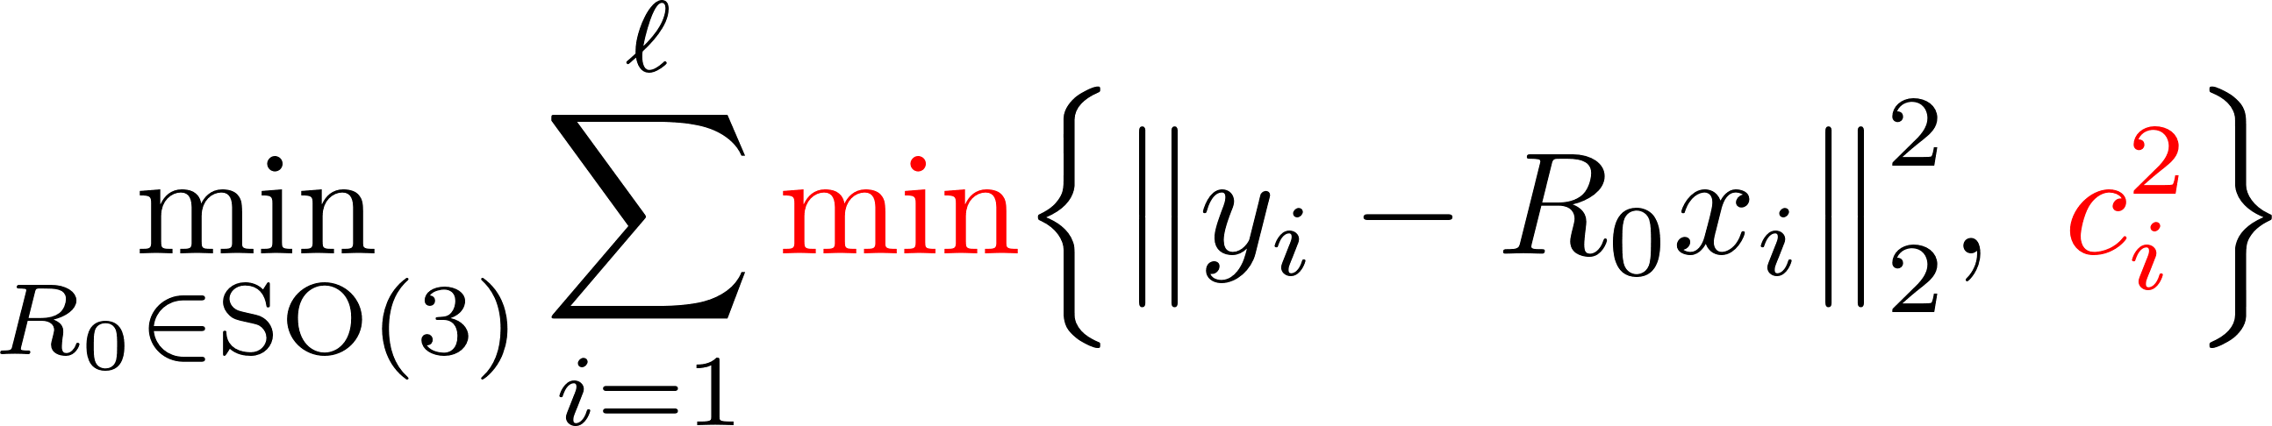
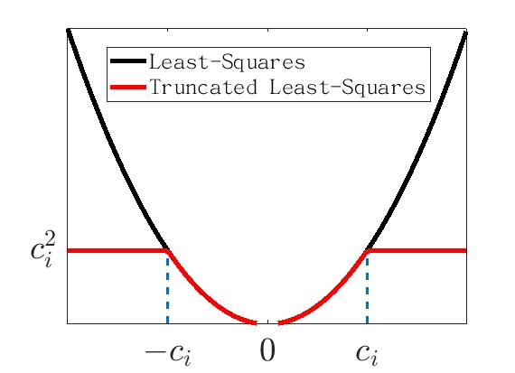
Truncated Least-Squares (Rotation)
(TLS-R)
(Huber, 1964) Truncation Parameter
Challenges of solving (TLS-R):
Non-Convexity
Non-Smoothness
No algorithm can approximately solve it in polynomial time in the worse case (Antonante et al., 2021)
[1] Antonante, P., Tzoumas, V., Yang, H., Carlone, L.: Outlier-robust estimation: Hardness, minimally tuned algorithms, and applications. IEEE Transactions on Robotics (2021)
[2] Tat-Jun, C., Zhipeng, C., Neumann, F.: Robust fitting in computer vision: Easy or hard? International Journal of Computer Vision 128(3), 575–587 (2020)

Slide 5
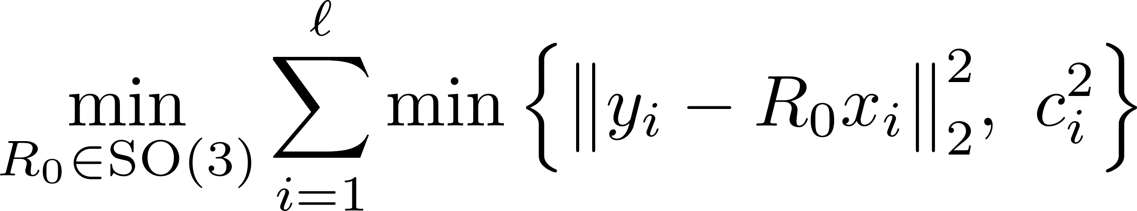
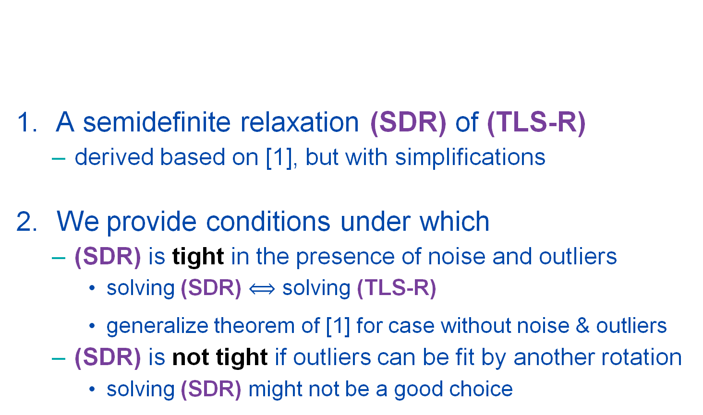
Our Contributions
A semidefinite relaxation (SDR) of (TLS-R)
derived based on [1], but with simplifications
We provide conditions under which
(SDR) is tight in the presence of noise and outliers
solving (SDR) solving (TLS-R)
generalize theorem of [1] for case without noise & outliers
(SDR) is not tight if outliers can be fit by another rotation
solving (SDR) might not be a good choice
(TLS-R)
[1] H. Yang and L. Carlone. A quaternion-based certifiably optimal solution to the Wahba problem with outliers. ICCV 2019.

Slide 6
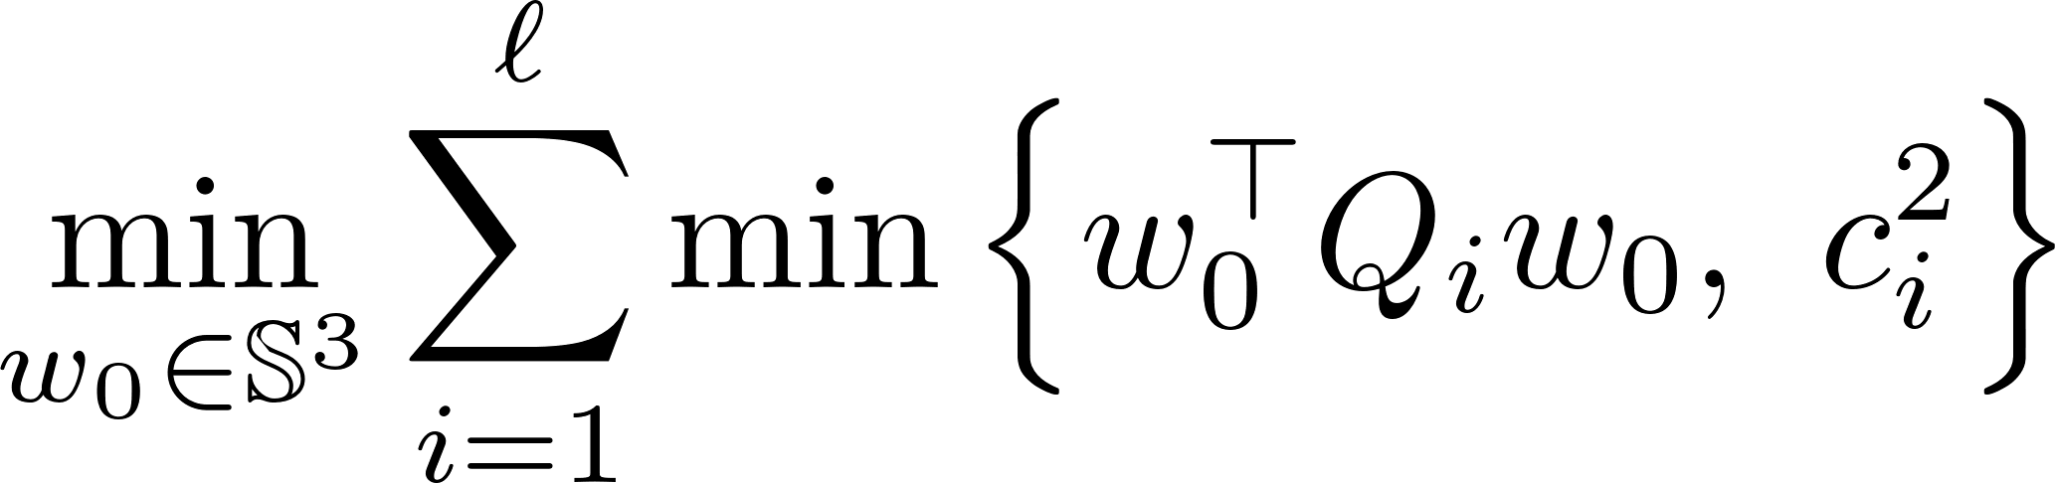
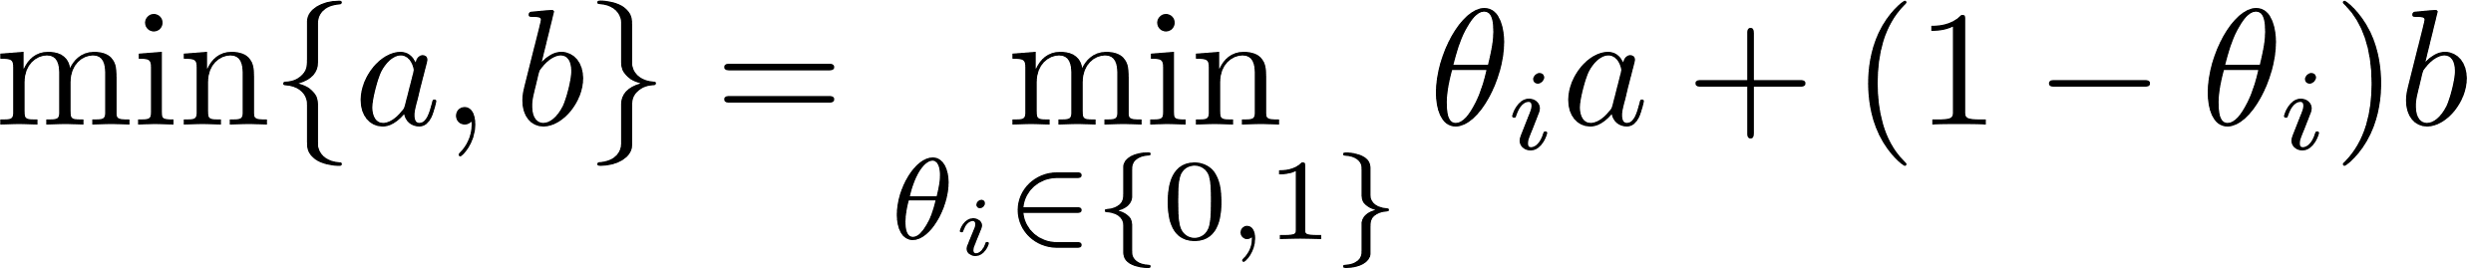
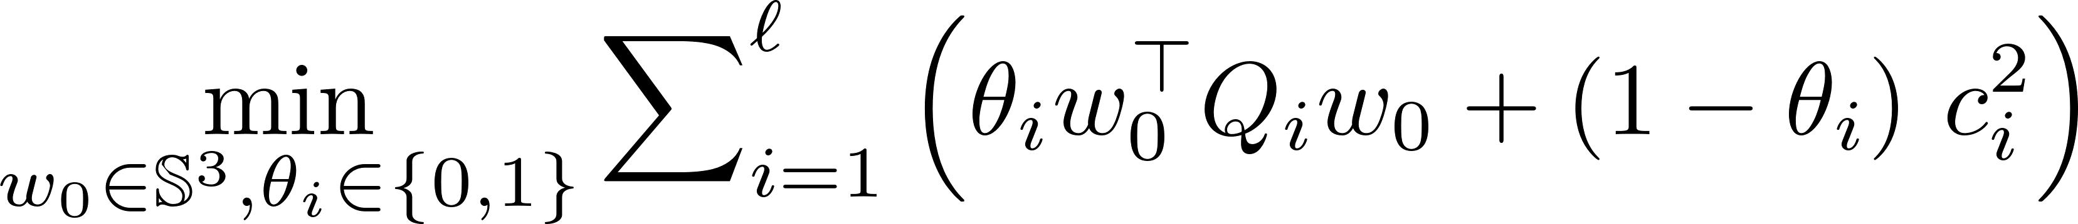

Derivation: From (TLS-R) to (SDR)
(TLS-R) $\underset{⇔}{(1)}$ (TLS-Q) $\underset{⇔}{\left(2\right), (3)}$ (QCQP) $\underset{⇒}{\left(4\right) lifting}$ (SDR)
Step (1): 3D rotations $R_{0} \overset{⇔}{ }$ unit quaternions $w_{0}$
Step (2): $i$-th inner min. binary choice $θ_{i}∈\{0,1\}$
(TLS-R)
(TLS-Q)
cubic

Slide 7

Derivation: From (TLS-R) to (SDR)
(TLS-R) $\underset{⇔}{(1)}$ (TLS-Q) $\underset{⇔}{\left(2\right), (3)}$ (QCQP) $\underset{⇒}{\left(4\right) lifting}$ (SDR)
cubic

Slide 8

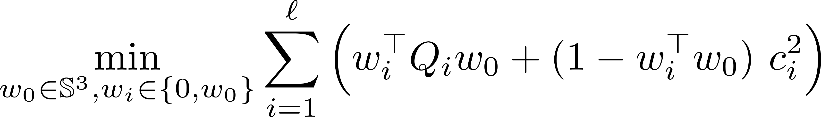

Derivation: From (TLS-R) to (SDR)
(TLS-R) $\underset{⇔}{(1)}$ (TLS-Q) $\underset{⇔}{\left(2\right), (3)}$ (QCQP) $\underset{⇒}{\left(4\right) lifting}$ (SDR)
Step (3): “Binary Clone” [1]:
(QCQP)
quadratic
[1] H. Yang and L. Carlone. A quaternion-based certifiably optimal solution to the Wahba problem with outliers. ICCV 2019.

Slide 9
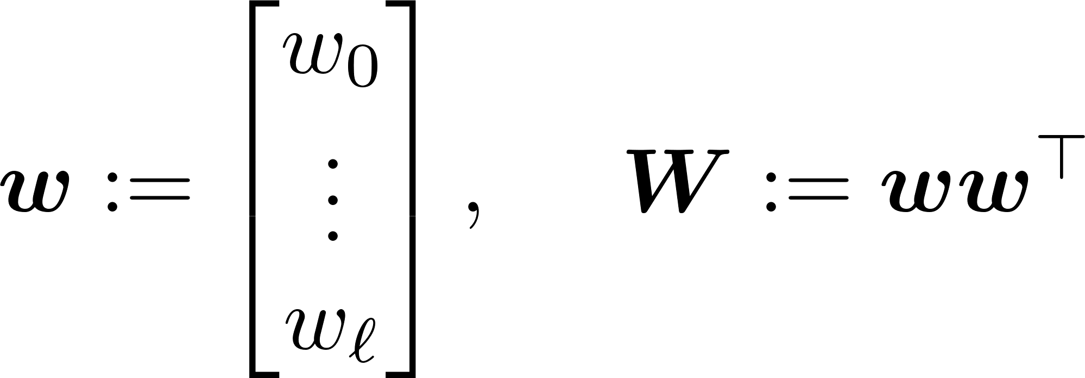
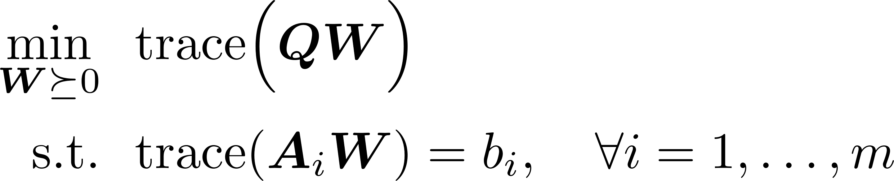

Derivation: From (TLS-R) to (SDR)
(TLS-R) $\underset{⇔}{(1)}$ (TLS-Q) $\underset{⇔}{\left(2\right), (3)}$ (QCQP) $\underset{⇒}{\left(4\right) lifting}$ (SDR)
Step (4): Lifting (remove the rank-1 constraint on $W$)
(QCQP)
(4)
(SDR)

Slide 10
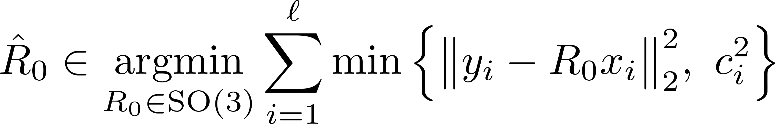
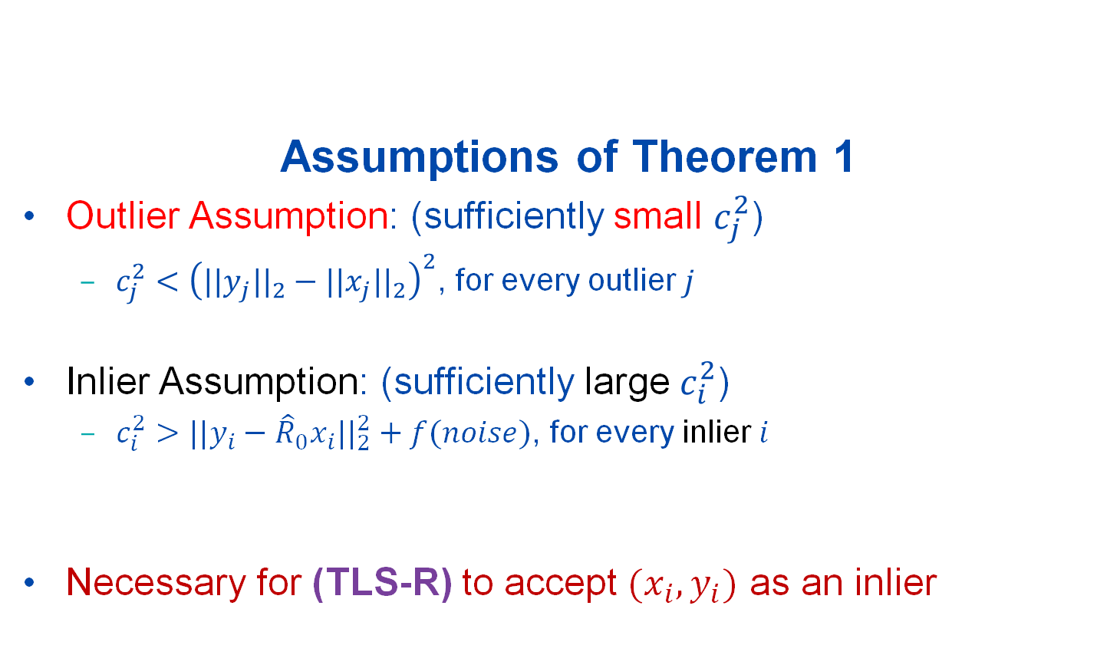
Tightness of (SDR): Theorem 1
Assumptions of Theorem 1
Outlier Assumption: (sufficiently small $c_{j}^{2}$)
$c_{j}^{2}<{\left({||y_{j}||}_{2}−{||x_{j}||}_{2}\right)}^{2}$, for every outlier $j$
Inlier Assumption: (sufficiently large $c_{i}^{2}$)
$c_{i}^{2}>{||y_{i}−{\hat{R}}_{0}x_{i}||}_{2}^{2}+f(noise)$, for every inlier $i$
Necessary for (TLS-R) to accept $(x_{i},y_{i})$ as an inlier
(TLS-R)
(1)

Slide 11
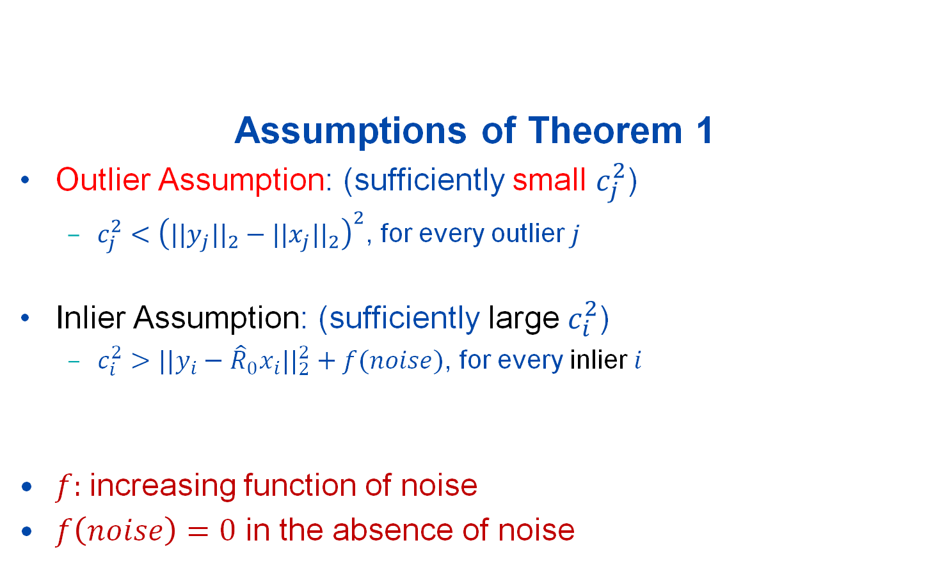
Tightness of (SDR): Theorem 1
Assumptions of Theorem 1
Outlier Assumption: (sufficiently small $c_{j}^{2}$)
$c_{j}^{2}<{\left({||y_{j}||}_{2}−{||x_{j}||}_{2}\right)}^{2}$, for every outlier $j$
Inlier Assumption: (sufficiently large $c_{i}^{2}$)
$c_{i}^{2}>{||y_{i}−{\hat{R}}_{0}x_{i}||}_{2}^{2}+f(noise)$, for every inlier $i$
$f$: increasing function of noise
$f\left(noise\right)=0$ in the absence of noise
(TLS-R)
(2)

Slide 12

Tightness of (SDR): Theorem 1
Assumptions of Theorem 1
Outlier Assumption: (sufficiently small $c_{j}^{2}$)
$c_{j}^{2}<{\left({||y_{j}||}_{2}−{||x_{j}||}_{2}\right)}^{2}$, for every outlier $j$
Inlier Assumption: (sufficiently large $c_{i}^{2}$)
$c_{i}^{2}>{||y_{i}−{\hat{R}}_{0}x_{i}||}_{2}^{2}+f(noise)$, for every inlier $i$
(TLS-R)
Theorem 1
Under the Outlier Assumption and Inlier Assumption,
(SDR) is tight.

Slide 13




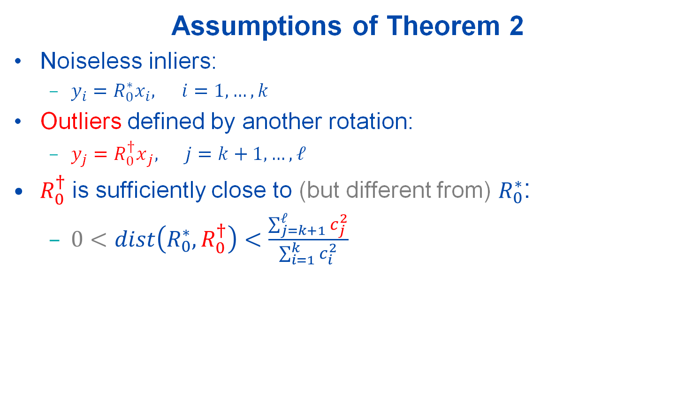




Tightness of (SDR): Theorem 2
Assumptions of Theorem 2
Noiseless inliers:
${{y_{i}=R}_{0}^{∗}x}_{i}, i=1,…,k$
Outliers defined by another rotation:
$y_{j}={R_{0}^{†}x}_{j}, j=k+1,…,ℓ$
$R_{0}^{†}$is sufficiently close to (but different from) $R_{0}^{∗}$:
$0<dist\left(R_{0}^{∗},R_{0}^{†}\right)<\frac{\sum_{j=k+1}^{ℓ}{c_{j}^{2}}}{\sum_{i=1}^{k}{c_{i}^{2}}}$
$$R_{0}^{∗}$$
$$x_{i}$$
$$y_{i}$$
$$x_{j}$$
$$y_{j}$$
$$R_{0}^{†}$$
Theorem 2
Under these assumptions, (SDR) is NOT tight.
$$dist\left(R_{0}^{∗},R_{0}^{†}\right)≔2−2\cos\left(\frac{angle\left(R_{0}^{∗},R_{0}^{†}\right)}{2}\right)$$

Slide 14
Conclusions and Future Work
A semidefinite relaxation (SDR) of (TLS-R)
We provide conditions under which
(SDR) is tight in the presence of noise and outliers
(SDR) is not tight if outliers can be fit by another rotation
Future Work
Computation: Solve (SDR) faster by exploiting its structure
Theory: Derive tighter conditions
(TLS-R)

Slide 15
Robust Rotation Search: Algorithms (Part II)
“ARCS: Accurate Rotation and Correspondence Search”
CVPR 2022 (21 pages)
Liangzu Peng, Manolis C. Tsakiris, Rene Vidal

Slide 16
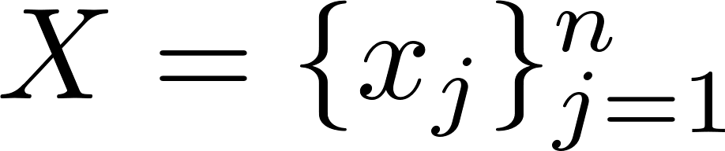
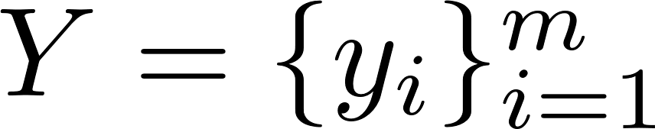
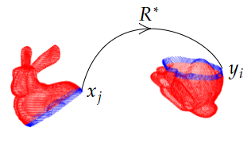
Problem Setup
Correspondence-Less (Partially Overlapped)
additive noise
Goal:

Slide 17
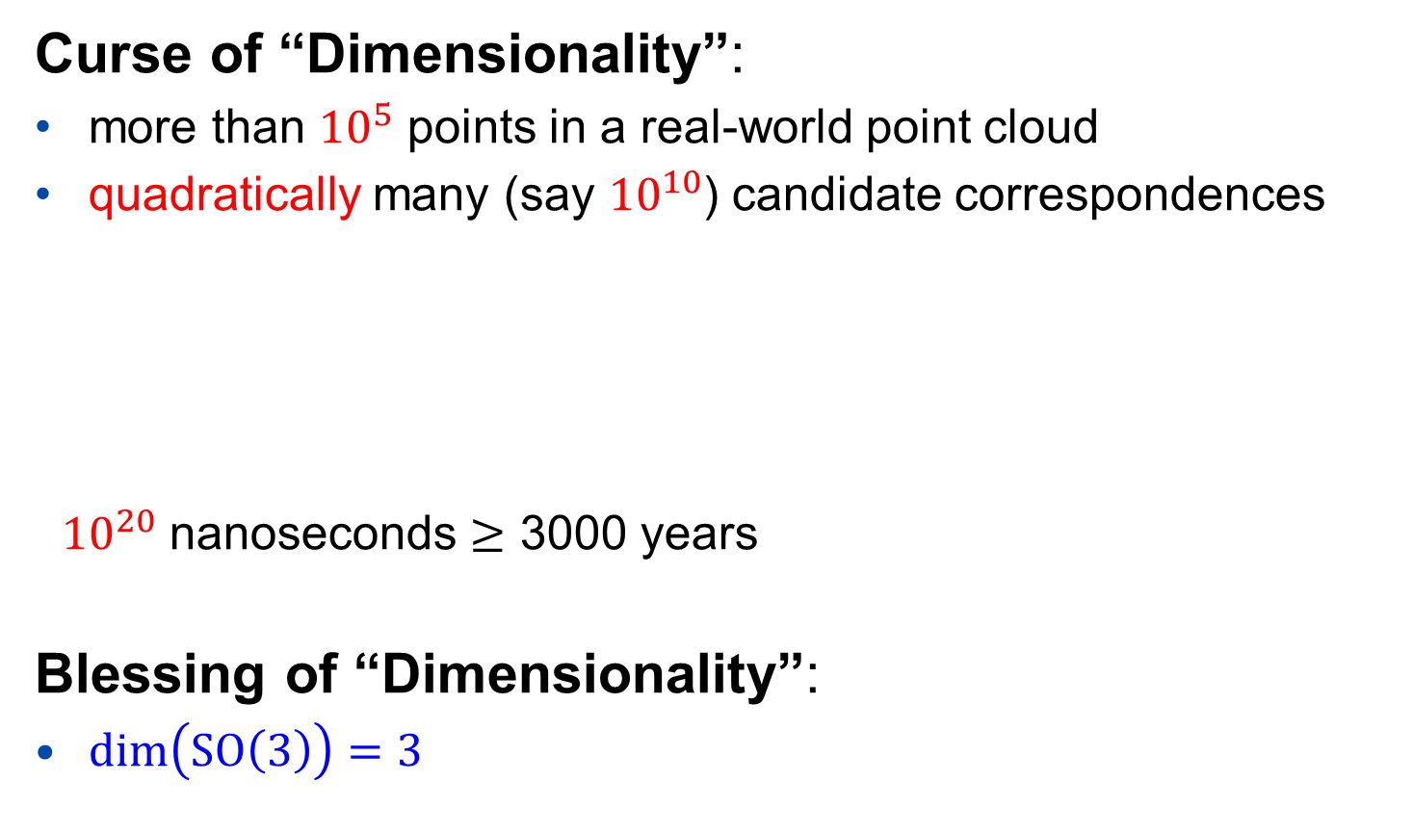
The Curse and Blessing
Curse of “Dimensionality”:
more than ${10}^{5}$ points in a real-world point cloud
quadratically many (say ${10}^{10}$) candidate correspondences
${10}^{20}$ nanoseconds $≥$ 3000 years
Blessing of “Dimensionality”:
$\dim\left(SO\left(3\right)\right)=3$
“Quadratic algorithms are useless
in modern applications.”
------ Robert Sedgewick

Slide 18
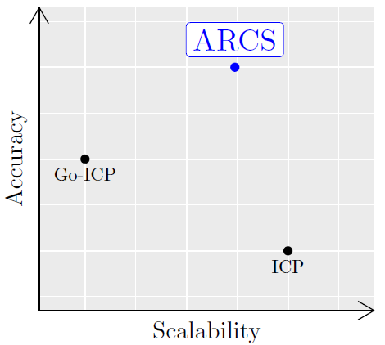
State of The Art
The ICP algorithm (and its variants)
+ preform well if adequately initialized
+ linear-logarithmic time complexity
- fails for most initializations
The Go-ICP algorithm (and its variants)
+ initialization-free
- exponential time complexity
Our algorithm: ARCS
+ initialization-free
+ linear-logarithmic time complexity
- rotation-only
Our Algorithm
ICP: P.J. Besl, N.D. McKay, “A Method for Registration of 3-D Shapes”. TPAMI 1992.
Go-ICP: J. Yang, H. Li, D. Campbell, Y. Jia, “Go-ICP: A Globally Optimal Solution to 3D ICP Point-Set Registration”, TPAMI 2016.

Slide 19
The ARCS Algorithm
ARCS consists of three steps:
Step 1: Establish Correspondences
Step 2: Outlier Removal
Step 3: Rotation Estimation and Refinement

Slide 20
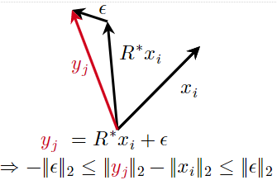
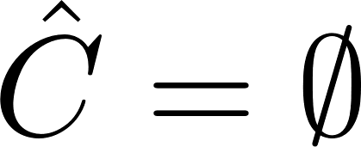
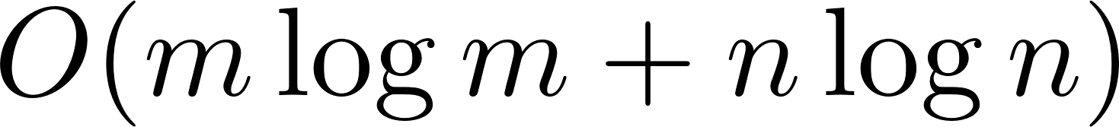
The ARCS Algorithm: Step 1
Step 1: Establish Correspondences
Initialization:
For every i=1,…,m, and j=1,…,n
Key Idea:
Step 1 can be implemented in linear-logarithmic time
Step 1 reduces the correspondence-less problem to Robust Rotation Search

Slide 21
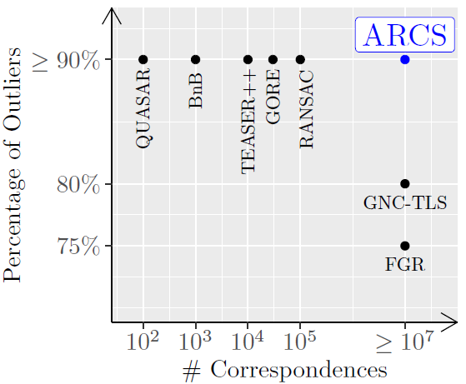

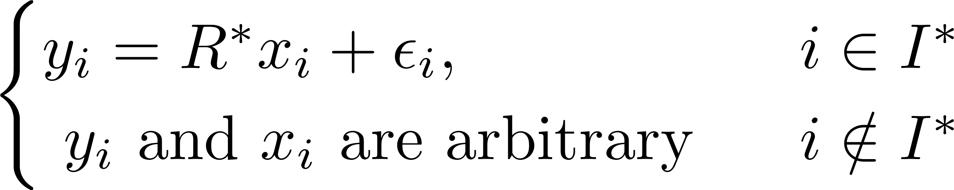
State of The Art
Our Solution (ARCS, Steps 2 and 3)
Robust Rotation Search Algorithms

Slide 22
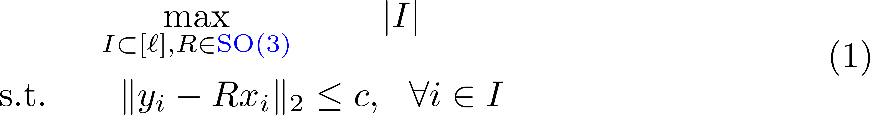
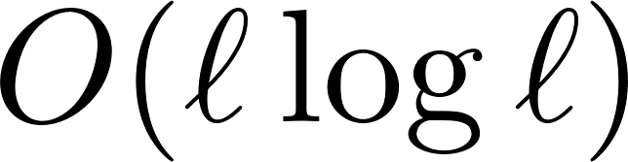
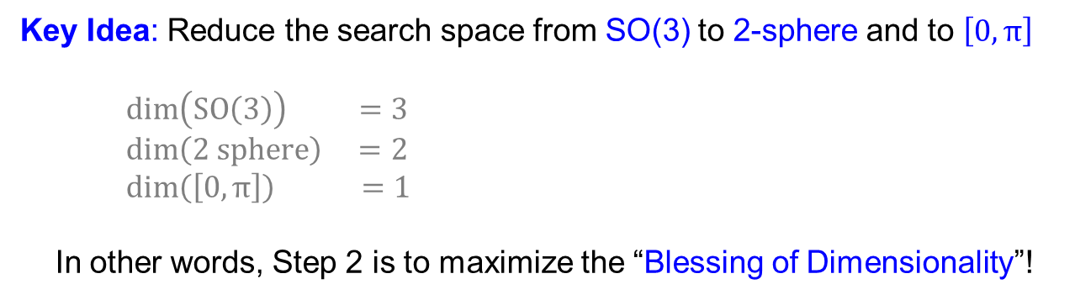
Step 2 of ARCS: Outlier Removal 1/2
Maximize the size of the inlier set I
In general NP-hard [1] (any feasible point is a local minimizer)
Claim:
(1) can be solved approximately in linear-logarithmic time
Key Idea: Reduce the search space from SO(3) to 2-sphere and to $\left[0,π\right]$
$\dim\left(SO\left(3\right)\right) =3$
$\dim\left(2 sphere\right) =2$
$\dim\left(\left[0,π\right]\right) =1$
In other words, Step 2 is to maximize the “Blessing of Dimensionality”!
[1]: T. Chin, Z. Cai, F. Neumann, Robust Fitting in Computer Vision:
Easy or Hard?, IJCV 2020

Slide 23
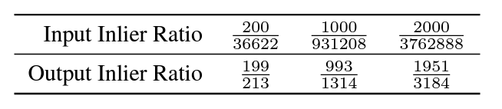
Step 2 of ARCS: Outlier Removal 2/2
Performance of Step 2
More than 3 million outlier point pairs are removed!
The final step:
Refine the rotation on the remaining point pairs
In the paper, we consider random, non-adversarial outliers

Slide 24
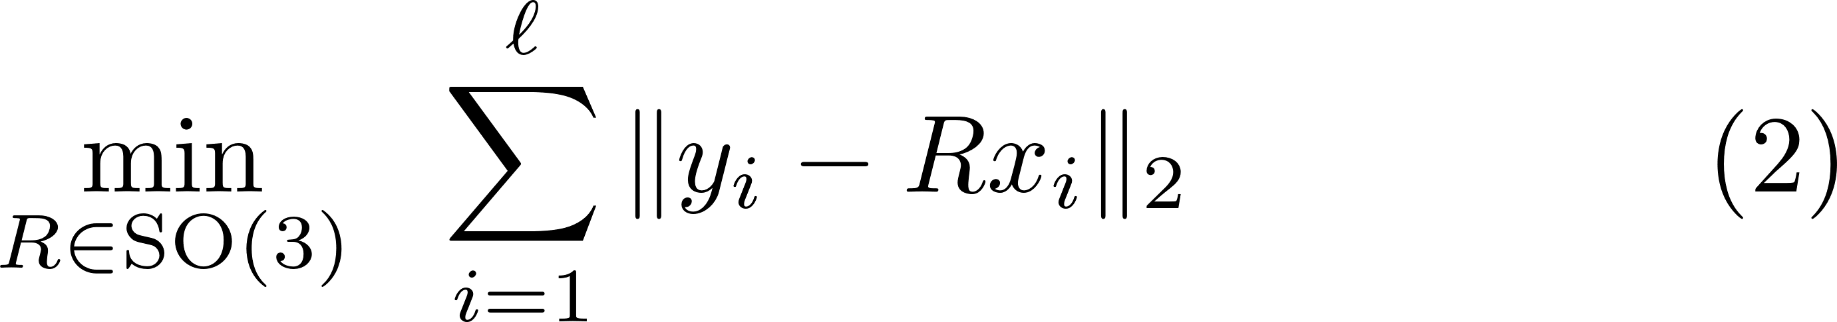
Step 3 of ARCS: Rotation Refinement 1/3
“Sum of Unsquared Deviations”:
Non-Convex (due to the constraint)
Non-Smooth (due to the objective)
The First Thought:
Riemannian Subgradient Descent
Problem: hard to derive theoretical guarantees
E.g., SO(3) has a determinant constraint

Slide 25
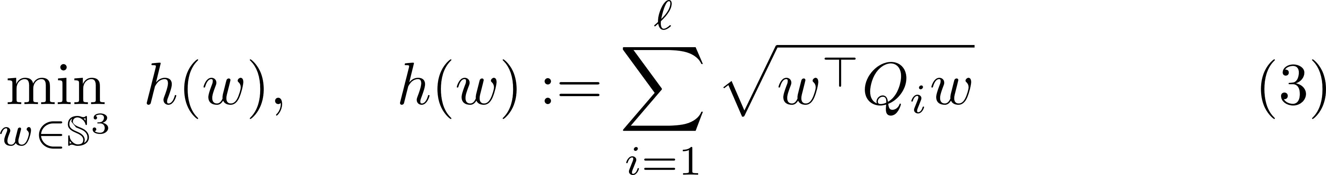
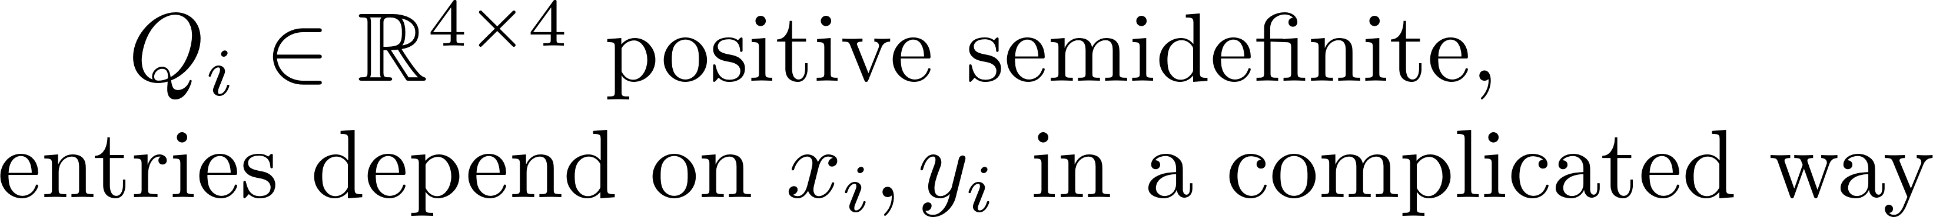
Step 3 of ARCS: Rotation Refinement 2/3
“Sum of Unsquared Deviations”:
Non-Convex (due to the constraint)
Non-Smooth (due to the objective)
The Second Thought:
Riemannian Subgradient Descent on Unit Quaternions
Claim: (2) is equivalent to

Slide 26
Step 3 of ARCS: Rotation Refinement 3/3
“Sum of Unsquared Deviations”:
Non-Convex (due to the constraint)
Non-Smooth (due to the objective)
The Final Algorithm:
Claim: Under certain regularity conditions, the algorithm converges locally at a linear rate, e.g.,

Slide 27
ARCS: Scalability & Accuracy in Numbers
ARCS is correspondence-free and can handle:
more than a million points with 2 overlapping points without noise
roughly ten thousand points with 20% overlaps under small noise
ARCS (Steps 2 and 3) can handle:
ten million point pairs with 0.03% inliers
See our paper for more formal experimental report.

Slide 28
Conclusion and Future Work
Conclusion:
ARCS has three steps, each step solved in
linear-logarithmic time:
Establish Correspondences
Outlier Removal
Rotation Estimation and Refinement
Future Work:
Extend ARCS to the rotation + translation case

Slide 29
More Information
Vision Lab @ JHU http://www.vision.jhu.edu
Center for Imaging Science @ JHU http://www.cis.jhu.edu
Mathematical Institute for Data Science @ JHU http://www.minds.jhu.edu
Thank You!

